Slide 1


X’Lenske Sampson
27 August 2023

Slide 2

Outline
Executive Summary
Introduction
Methodology
Results
Conclusion
Appendix

Slide 3
Executive Summary
Summary of methodologies
Data Collection API
Web Scrapping
EDA with Data Visualization
EDA with SQL
Interactive Map – Folium
Dashboards
Predictive Analysis
Summary of all results
EDA
Maps and Dashboards
Perdictive

Slide 4
Introduction
In this capstone, we will predict if the Falcon 9 first stage will land successfully. SpaceX advertises Falcon 9 rocket launches on its website with a cost of 62 million dollars; other providers cost upward of 165 million dollars each, much of the savings is because SpaceX can reuse the first stage.
Therefore if we can determine if the first stage will land, we can determine the cost of a launch. This information can be used if an alternate company wants to bid against SpaceX for a rocket launch.

Slide 5

Section 1

Slide 6
Methodology
Executive Summary
Data collection methodology:
Data was collected from SpaceX API
Web Scrapping from Wikipedia
Perform data wrangling
Dropping irrelevant columns
One Hot Encoding for classification models
Perform exploratory data analysis (EDA) using visualization and SQL
Perform interactive visual analytics using Folium and Plotly Dash
Perform predictive analysis using classification models
How to build, tune, evaluate classification models

Slide 7
Data Collection
SPACE X API call
Returns JSON
Dataframe from JSON
Clean Data and Report
Data collected from SPACE API & web scrapping Wiki
API allowed exaction of rocket, launchpad, payload
Web scrapping of Wiki launches, landing, and payload
GET HTML
Extract Data: Beautiful Soup
Create Dataframe
Export Data

Slide 8
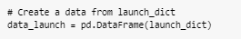
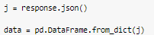
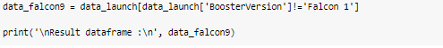
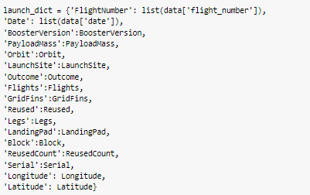
Data Collection – SpaceX API
1. Parse SpaceX launch data using the GET
4. Create Dataframe
2. Decode JSON turn in data frame using normalize
5. Filter data for Falcon 9 rocket
3. Construct Dataset
6. Export CSV
GitHub URL of SpaceX API

Slide 9
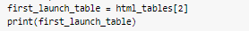
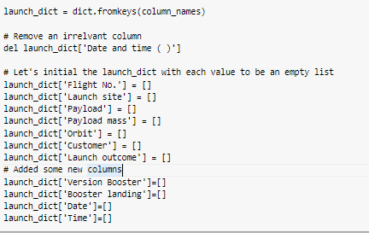
Data Collection - Scraping
1. Request Fal9 launch Wiki from URL
6. Export CSV
2. Extract all column/variable names from HTML
3. Create dataframe by parsing HTML
GitHub URL of Scrapping

Slide 10
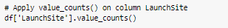
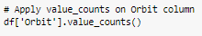
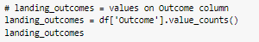
Data Wrangling
In the data set, there are several different cases where the booster did not land successfully. Sometimes a landing was attempted but failed due to an accident; for example, True Ocean means the mission outcome was successfully landed to a specific region of the ocean while False Ocean means the mission outcome was unsuccessfully landed to a specific region of the ocean. True RTLS means the mission outcome was successfully landed to a ground pad False RTLS means the mission outcome was unsuccessfully landed to a ground pad. True ASDS means the mission outcome was successfully landed on a drone ship False ASDS means the mission outcome was unsuccessfully landed on a drone ship.
GitHub URL data wrangling
1. Calculate # of launches ea. site
4. Create landing outcome label
2. Calculate # & occurrence ea. orbit
5. Success Rate Mean
3. Calculate # & occ of mission outcome
6. Export CSV

Slide 11
EDA with Data Visualization
Catplots
Flight Number vs. PayloadMass
Flight Number vs. LaunchSite
PayloadMass vs LaunchSite
Orbit vs. Flight Number
PayloadMass vs Orbit
Orbit vs. PayloadMass
Relationship between variables
GitHub URL EDA with data visualization
Bar Graph
Success Rate vs. Orbit
Relationship between numeric and categorical variables
Line Graph
Success Rate vs. Year
Trend analysis

Slide 12
EDA with SQL
SQL queries performed
Display the names of the unique launch sites in the space mission
Display 5 records where launch sites begin with the string 'CCA’
Display the total payload mass carried by boosters launched by NASA (CRS)
Display average payload mass carried by booster version F9 v1.1
List the date when the first successful landing outcome in ground pad was achieved.
List the names of the boosters which have success in drone ship and have payload mass greater than 4000 but less than 6000
List the total number of successful and failure mission outcomes
List the names of the booster_versions which have carried the maximum payload mass. Use a subquery
List the records which will display the month names, failure landing_outcomes in drone ship ,booster versions, launch_site for the months in year 2015.
Rank the count of landing outcomes (such as Failure (drone ship) or Success (ground pad)) between the date 2010-06-04 and 2017-03-20, in descending order.
GitHub URL EDA with SQL

Slide 13
Build an Interactive Map with Folium
Create a Folium Map, object with an initial center location NASA Johnson Space Center at Houston, Texas
Create a blue circle at NASA Johnson Space Center's coordinate with a popup label showing its name
Marker locations of launch locations in Florida & California
Mark the success/failed launches for each site green(1), red(0)
Add markers for each launch result
Calculate the distances between a launch site to its proximities
Create a marker with distance to a closest city, railway, highway, etc.
Draw a line between the marker to the launch site
GitHub URL interactive map with Folium map

Slide 14
Build a Dashboard with Plotly Dash
Dashboard has dropdown, piechart, scatterplot
Dropdown can choose one site or all sites
Pie chart total success/failure
Scatterplot relationship between Success & PayloadMass
GitHub URL Plotly Dash

Slide 15
Predictive Analysis (Classification)
Data Prep
Load
Normalize
Split data
Model Prep
ML algorithms
Set parameters
Train GridsearchCV
Model evaluation
Best hyperparameters
Find accuracy
Confusion matrix for ea algorithm
Comparsion
Compare results
GitHub URL predictive analysis

Slide 16
Results
Exploratory data analysis results
Interactive analytics demo in screenshots
Predictive analysis results

Slide 17

Section 2

Slide 18
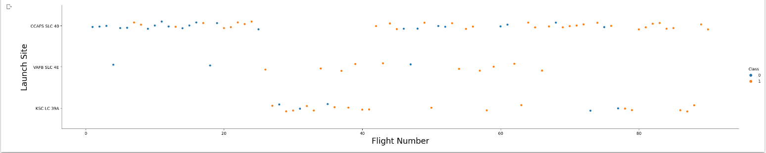
Flight Number vs. Launch Site
All sites increase in success after each flight

Slide 19
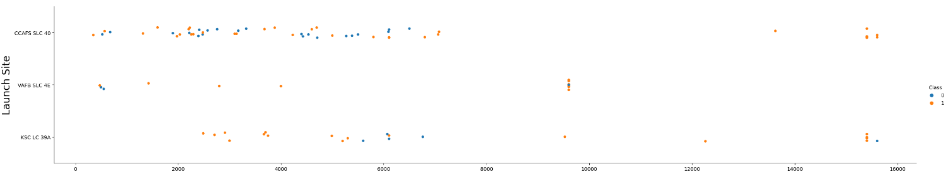
Payload vs. Launch Site
CCAFS SLC 40 100% success after 10000kg
No payloads larger than 10000kg for VAFB SLC 4E

Slide 20
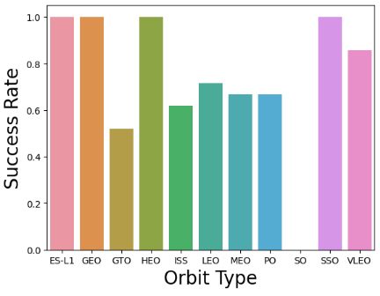
Success Rate vs. Orbit Type
Top Orbits
ES-L1, GEO, HEO, SSO
2nd Best
VLEO
Worst Orbits for launches
GTO, ISS, LEO, MEO, PO

Slide 21
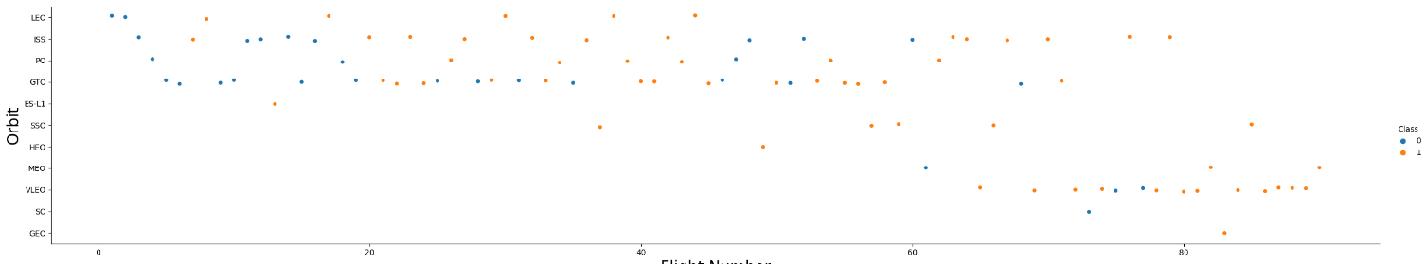
Flight Number vs. Orbit Type
In the LEO orbit the Success appears related to the number of flights; on the other hand, there seems to be no relationship between flight number when in GTO orbit.

Slide 22
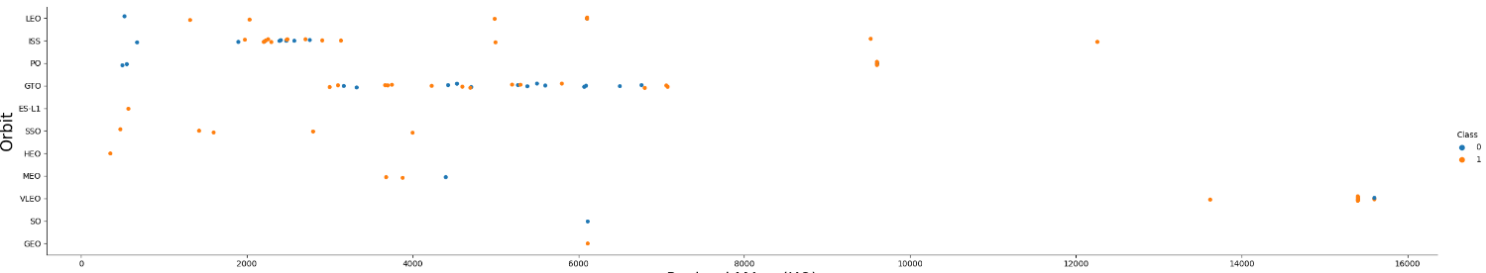
Payload vs. Orbit Type
With heavy payloads the successful landing or positive landing rate are more for Polar, LEO and ISS.
However for GTO we cannot distinguish this well as both positive landing rate and negative landing(unsuccessful mission) are both there here.

Slide 23
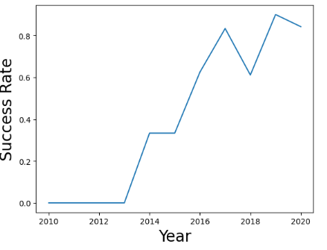
Launch Success Yearly Trend
Success rate since 2013 kept increasing till 2020

Slide 24
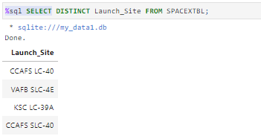
All Launch Site Names
Display the names of the unique launch sites
USE the DISTINCT function to remove duplicates

Slide 25
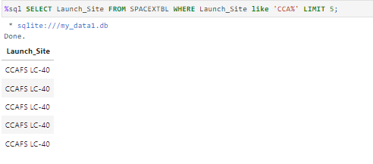
Launch Site Names Begin with 'CCA'
Find 5 records where launch sites begin with `CCA`
WHERE clause column name LIKE clause with percent sign to wildcart CCA

Slide 26
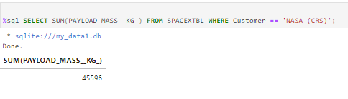
Total Payload Mass
Calculate the total payload carried by boosters from NASA
The total sum of all payloadmasskg where the customer is NASA

Slide 27
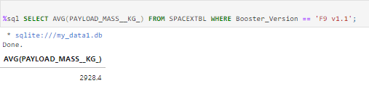
Average Payload Mass by F9 v1.1
Calculate the average payload mass carried by booster version F9 v1.1
Calculate average of payloadmasskg WHERE Booster is F9 v1.1

Slide 28
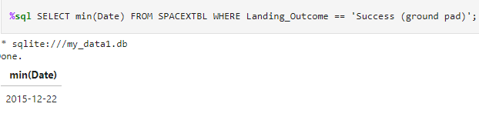
First Successful Ground Landing Date
Find the dates of the first successful landing outcome on ground pad
Min looks for first success date WHERE filters column returning results equal to ground pad

Slide 29
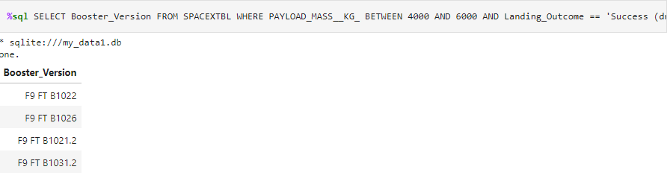
Successful Drone Ship Landing with Payload between 4000 and 6000
List the names of boosters which have successfully landed on drone ship and had payload mass greater than 4000 but less than 6000
Start with column booster use WHERE clause to filter successfully landed drone ship

Slide 30
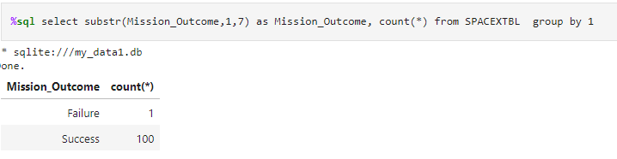
Total Number of Successful and Failure Mission Outcomes
Calculate the total number of successful and failure mission outcomes
Substr function to filter and count function

Slide 31
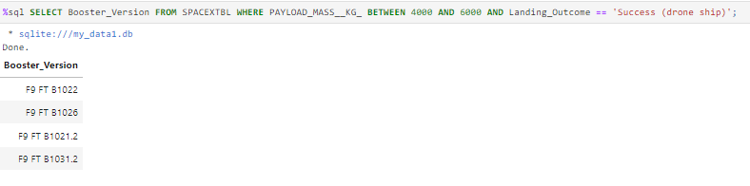
Boosters Carried Maximum Payload
List the names of the booster which have carried the maximum payload mass
Select column Booster, WHERE function to filter payload masskg and landing outcome

Slide 32
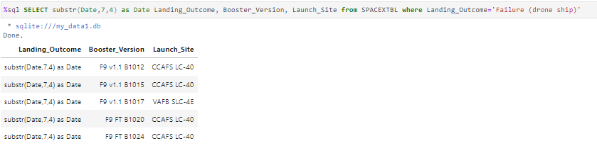
2015 Launch Records
List the failed landing outcomes in drone ship, their booster versions, and launch site names for in year 2015
Use substr to get date, DISTINCT function to remove duplicates, select columns, use WHERE function to filter landing outcome

Slide 33
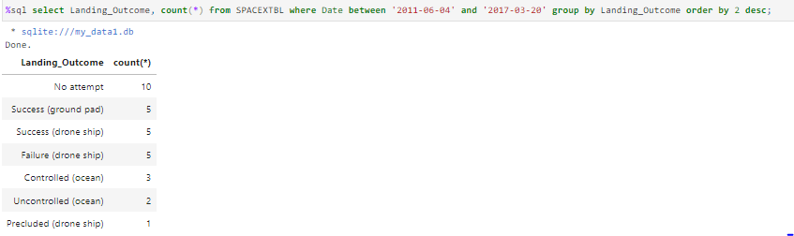
Rank Landing Outcomes Between 2010-06-04 and 2017-03-20
Rank the count of landing outcomes (such as Failure (drone ship) or Success (ground pad)) between the date 2010-06-04 and 2017-03-20, in descending order
USE WHERE function to filter DATE and BETWEEN for actual date range and grouped by landing outcome and ORDERBY function with DESC to desend in order

Slide 34

Section 3

Slide 35
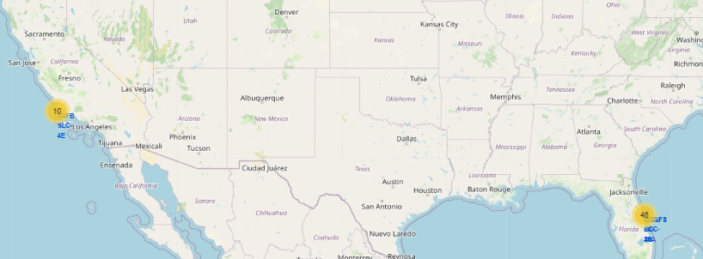
Folium Map Ground Stations
Space X has located ground stations on the East Coast and West Coast of the United States

Slide 36
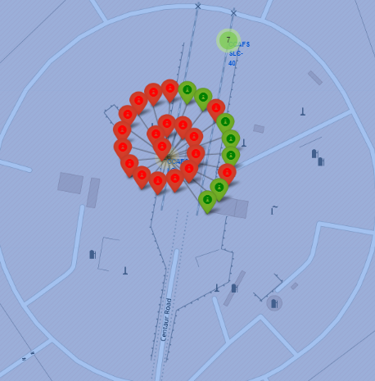
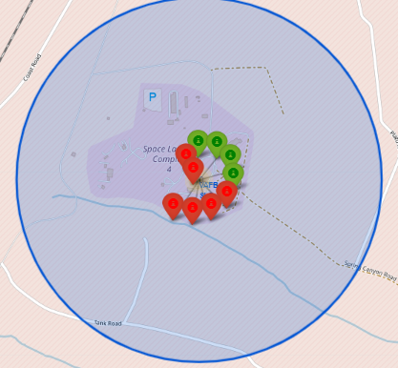
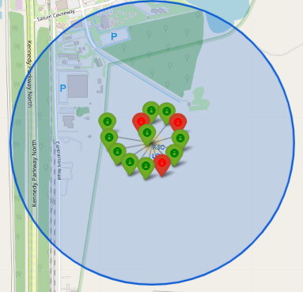
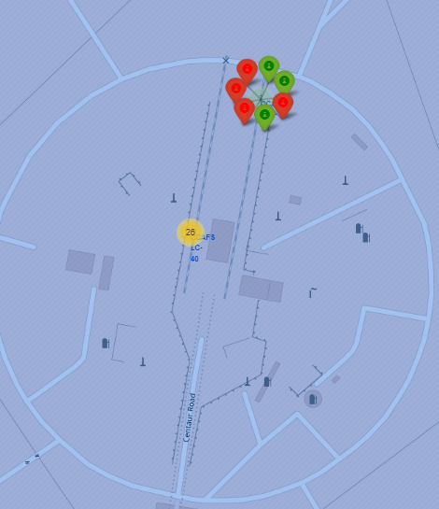
<Folium Map Color Labeled Markers
Green markers are the successful launches
Red markers are the unsuccessful launches
KSC LC-39A most sucessful

Slide 37
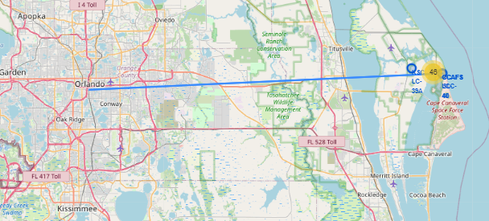
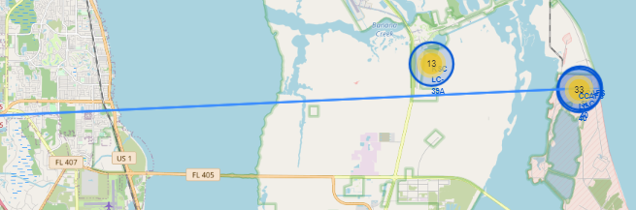
Folium Map Marker with Distance
Create a marker with distance to a closest city, railway, highway, etc.
Draw a line between the marker to the launch site

Slide 38

Section 4

Slide 39
<Dashboard Screenshot 1>
Replace <Dashboard screenshot 1> title with an appropriate title
Show the screenshot of launch success count for all sites, in a piechart
Explain the important elements and findings on the screenshot

Slide 40
<Dashboard Screenshot 2>
Replace <Dashboard screenshot 2> title with an appropriate title
Show the screenshot of the piechart for the launch site with highest launch success ratio
Explain the important elements and findings on the screenshot

Slide 41
<Dashboard Screenshot 3>
Replace <Dashboard screenshot 3> title with an appropriate title
Show screenshots of Payload vs. Launch Outcome scatter plot for all sites, with different payload selected in the range slider
Explain the important elements and findings on the screenshot, such as which payload range or booster version have the largest success rate, etc.

Slide 42

Section 5

Slide 43
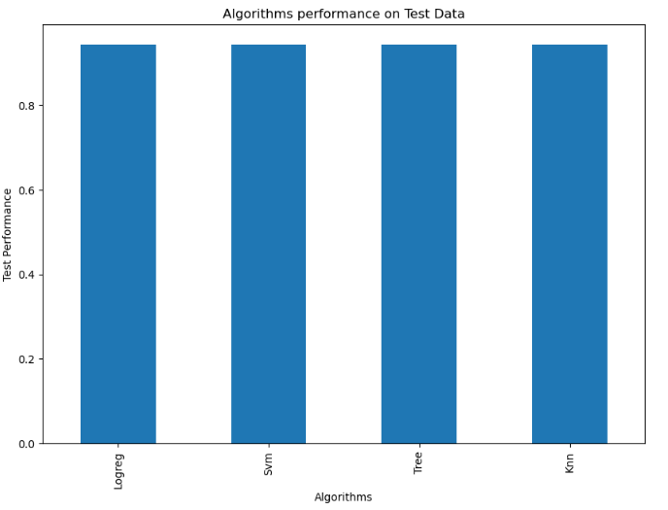
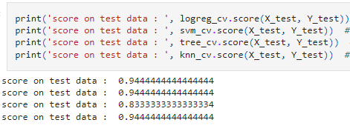
Classification Accuracy
Model accuracy was similar between all models

Slide 44
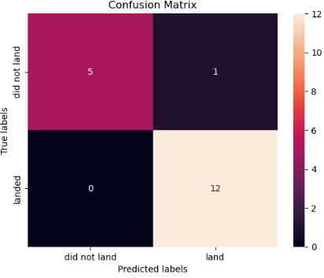
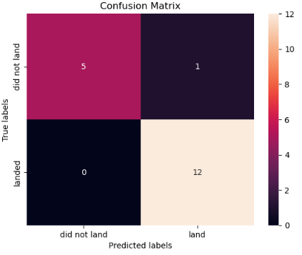
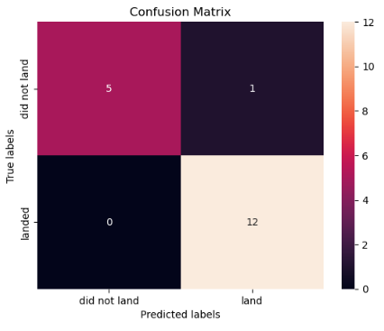
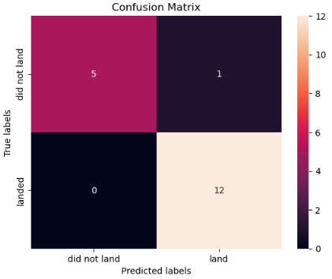
Confusion Matrix
SVM
Tree
KNN
LogReg
All algorithms performed the same

Slide 45
Conclusions
Mission success if launching rockets into space has been assessed by several factors like launch location site, weight of the payload, and the orbit of space to name a few.
The most successful rates are ES-L1, GEO, HEO SSO. VLEO was also very successful.
Noticeably, has more payloads were launch from 2012 to 2022 the success increased dramatically as it would seem errors of previous launches were corrected
The algorithms all performed the same in the testing so at this time no further adjustments or additional test date will need to be provided to see if the False positives can be further reduced

Slide 46


